Slide 1
5 m
2 m
5 m
2 m
2 m
Ant nest
2 m
Ant bait
Nest foraging area
225 5 x 5 m squares, grid of 256 points, plot is 75 x 75 m

Slide 2
3 m
2 m
3 m
2 m
2 m
Ant nest
2 m
Ant bait
Nest foraging area
225 3 x 3 m squares, grid of 256 points, plot is 45 x 45 m

Slide 3
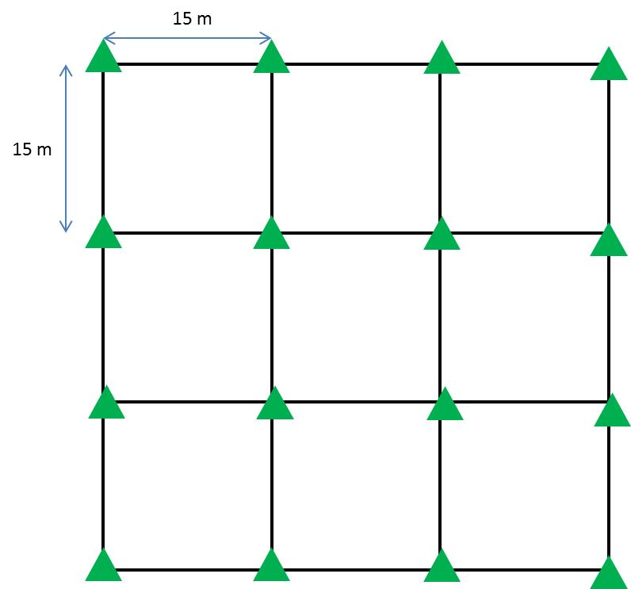
iButton
Large sticks
3 m

Slide 4
iButton
Large sticks
3 m

